Slide 1
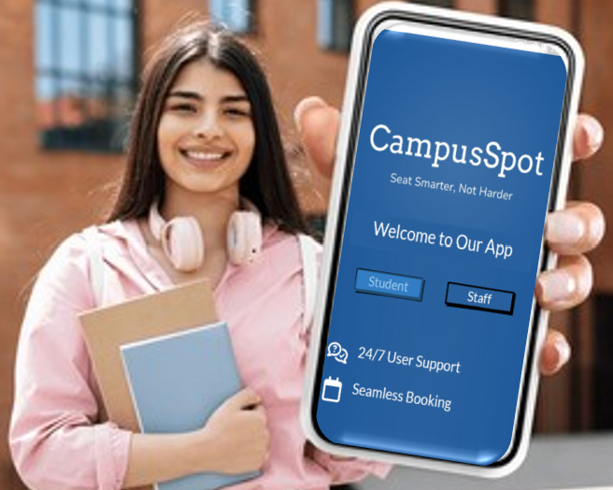
CampusSpot
Seat Smarter, Not Harder
Team 9
Nayana Magadi Nagaraj
Anagha Vasista
Bhakti Paithankar
Utkarsh Gupta

Slide 2

Quick Reminder: What is CampusSpot?
Problem: Unproductive Study Experience
Time wasted in finding spaces
Noise disrupt concentration
Inefficient space management
Customer Segments
Primary: Students
Secondary: Admins and staff

Slide 3
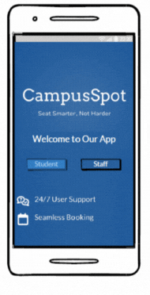
Proposed Solution
CampusSpot: Smart Study Space Management
Seamless booking with flexibility
Analytics to optimize allocation

Slide 4
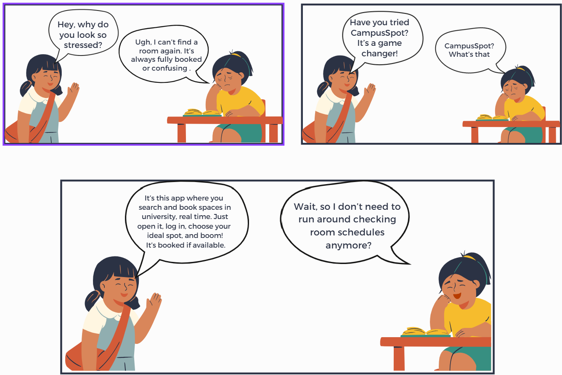
Storyboard Use Case –Space Booking

Slide 5
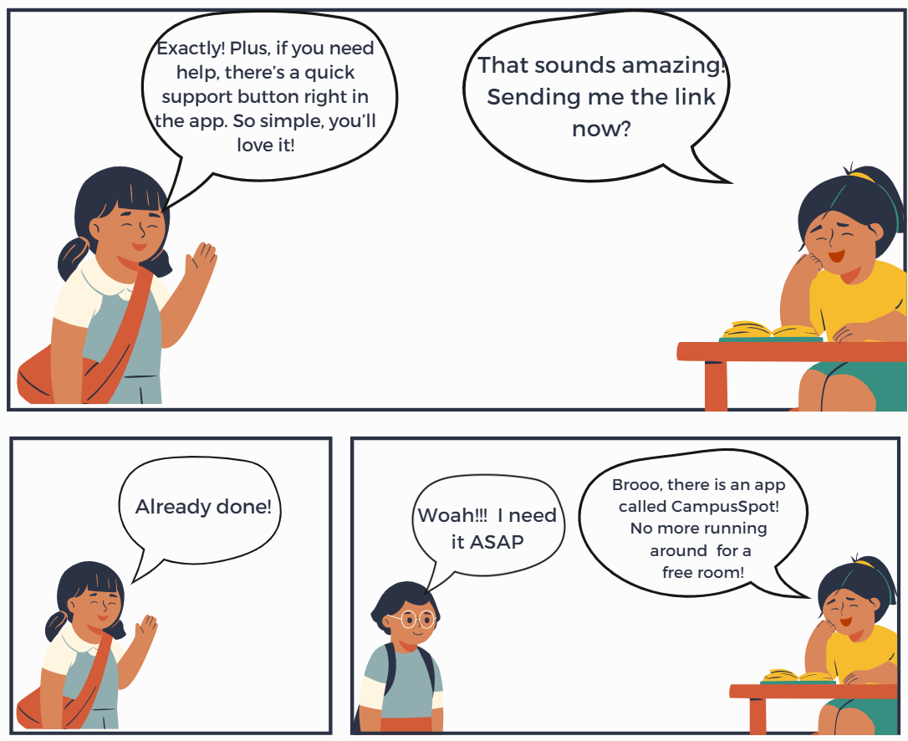
Storyboard Use Case –Space Booking

Slide 6
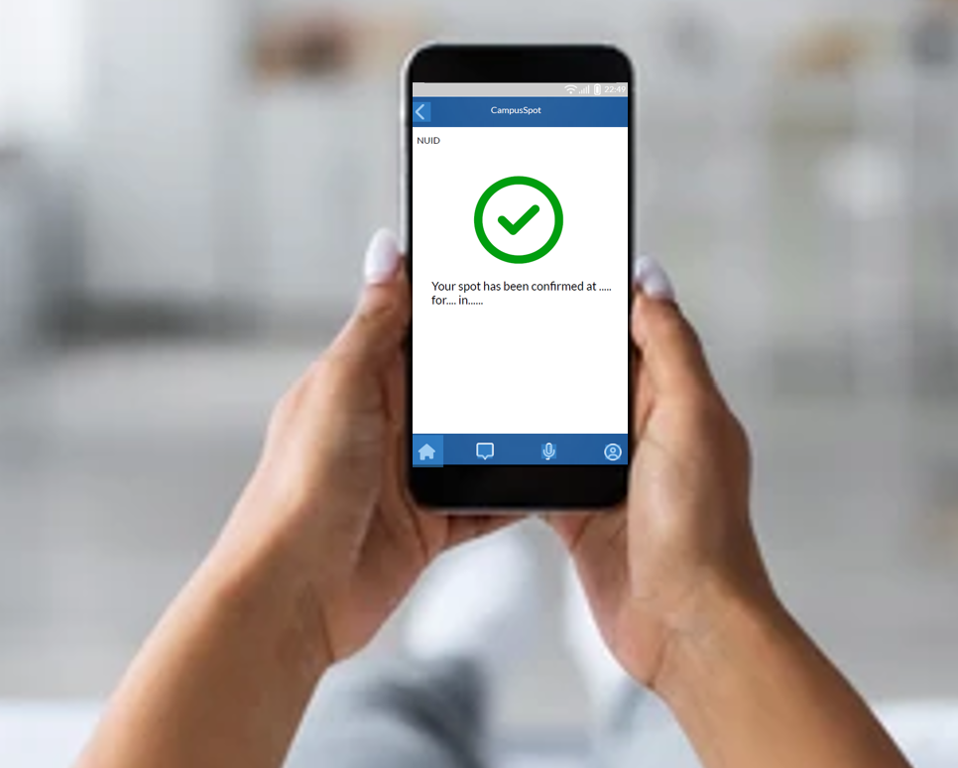
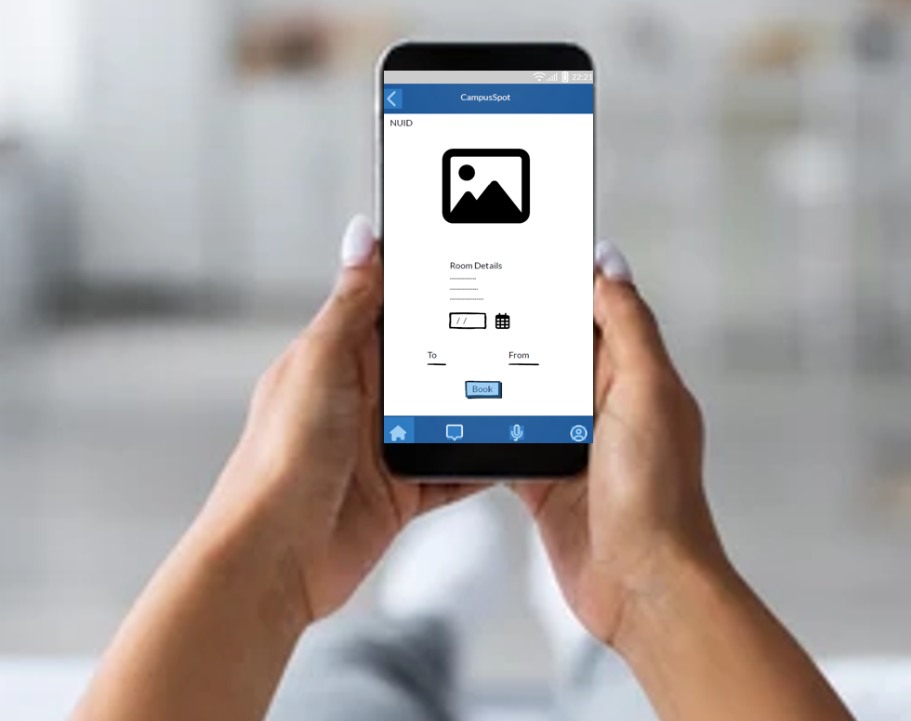
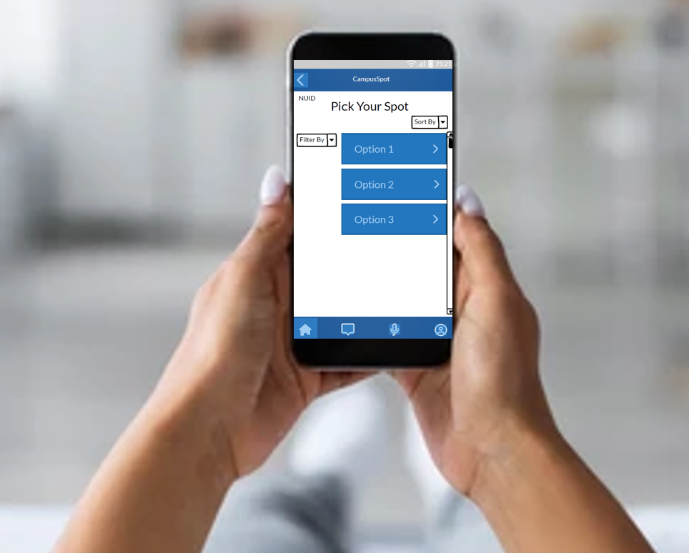
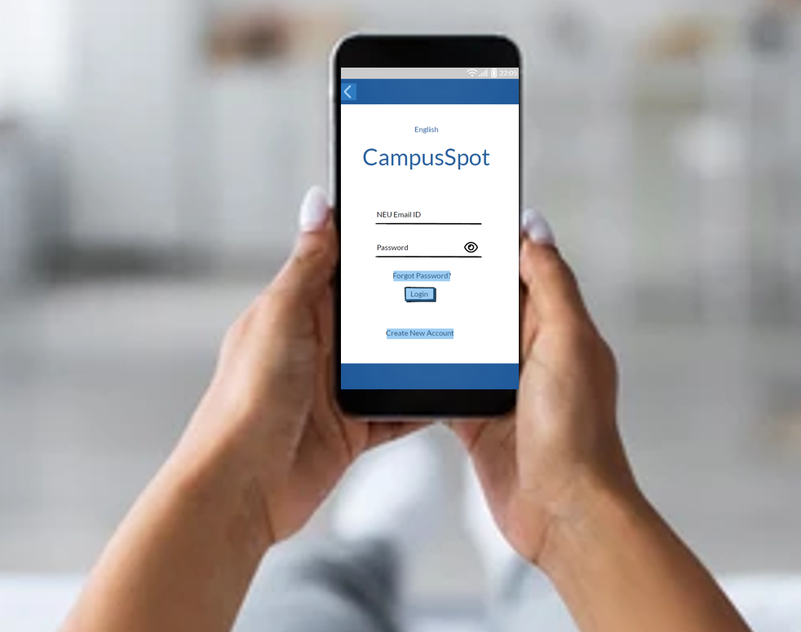
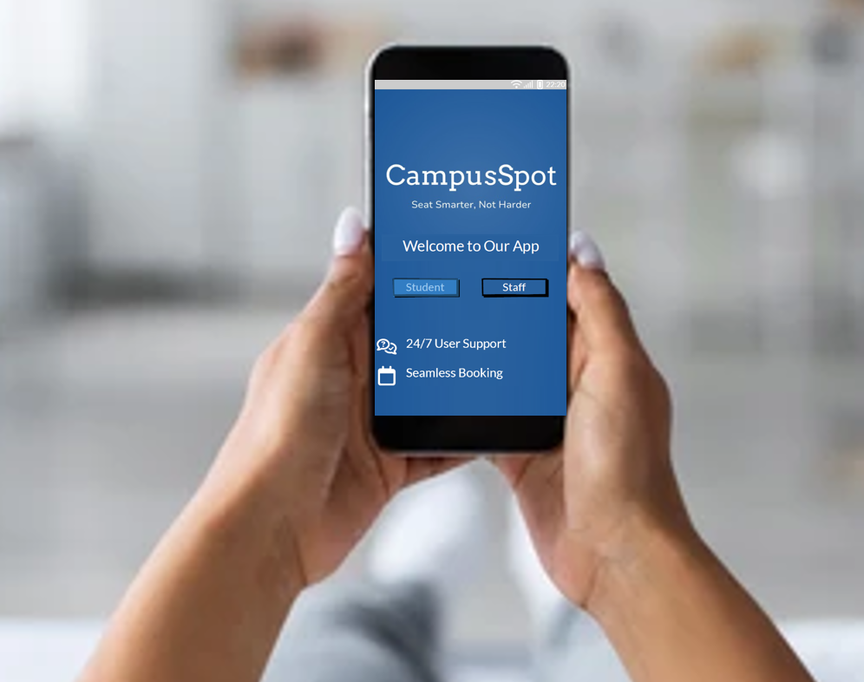
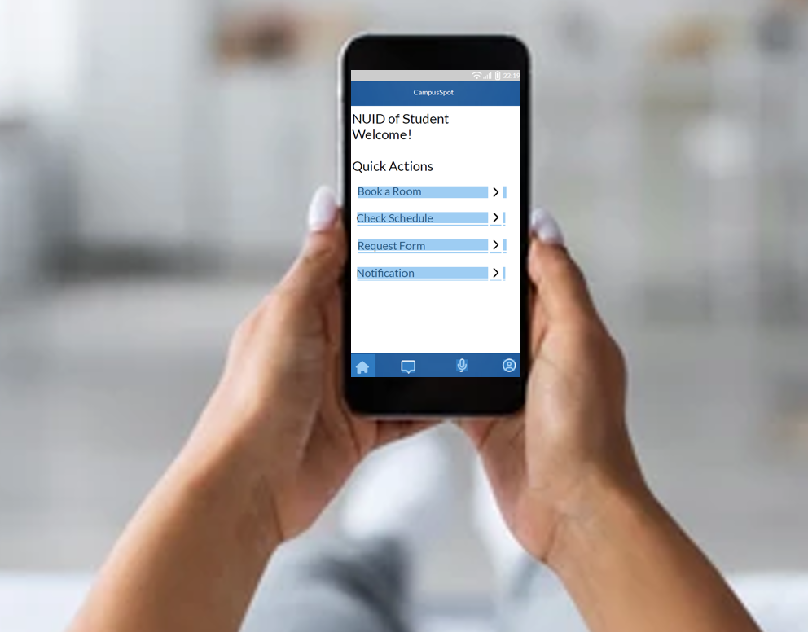






Storyboard: Key Use Case –Space Booking
Open the App
Login
Select room booking option
Choose a room
Choose date and time
Space confirmed if available

Slide 7
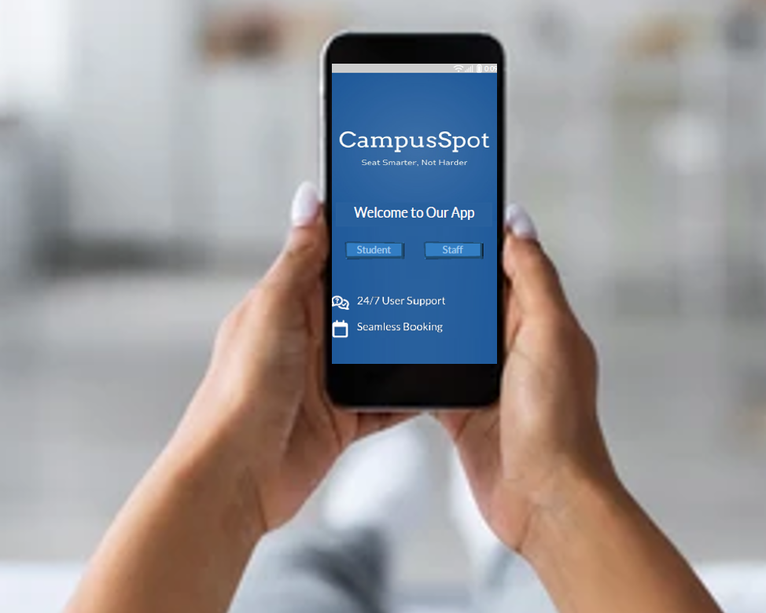
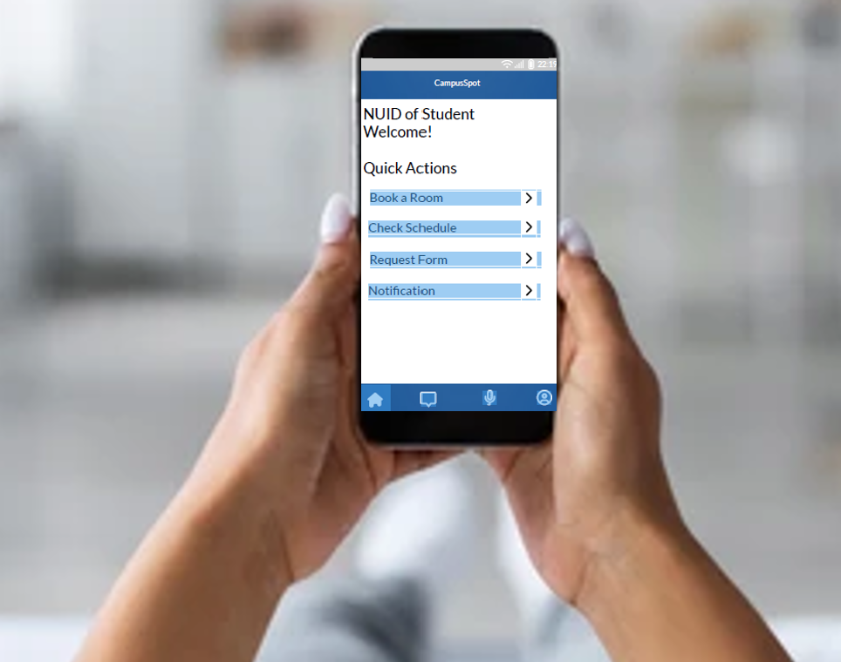
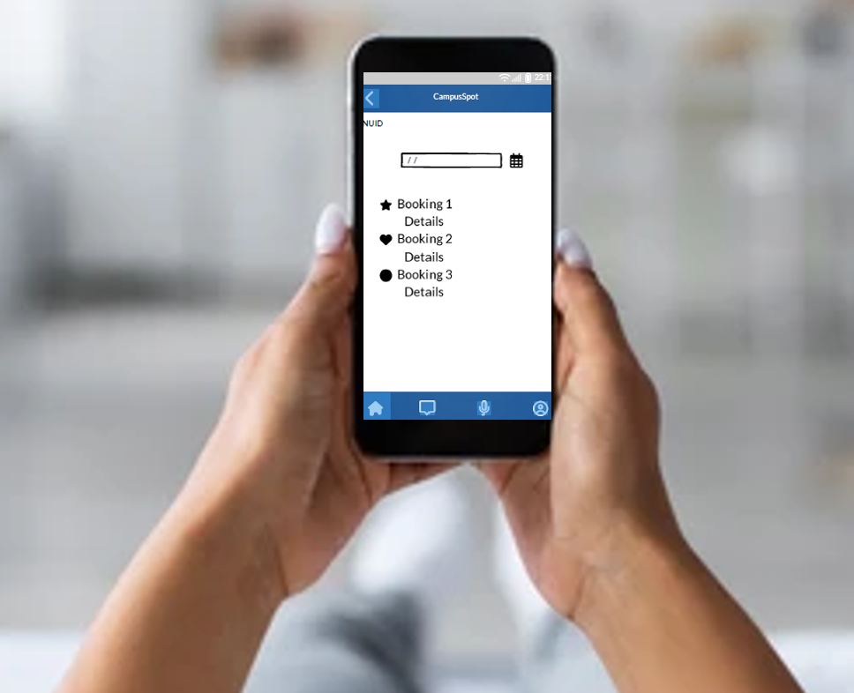
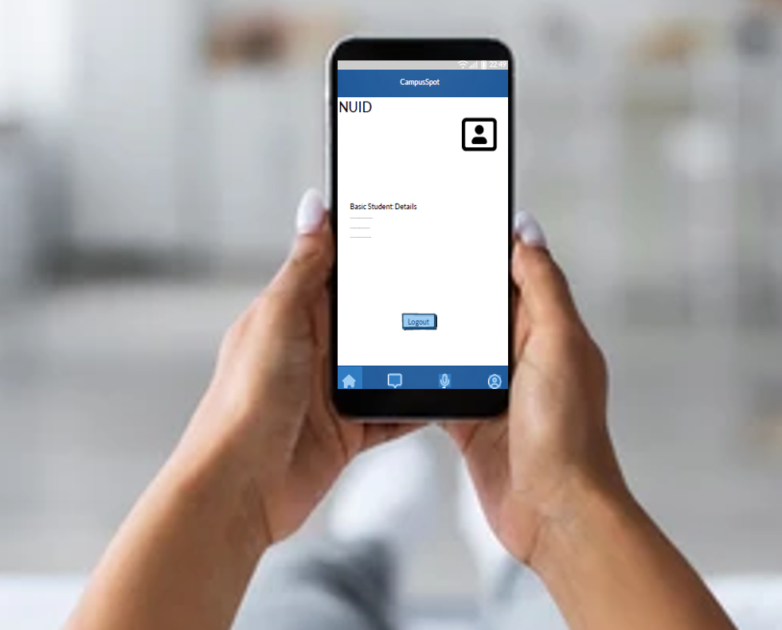



Storyboard: Key Use Case – Space Booking
Click on home
Select check schedule
Click on profile
Click on logout
Hurray Back to Landing Page!!

Slide 8
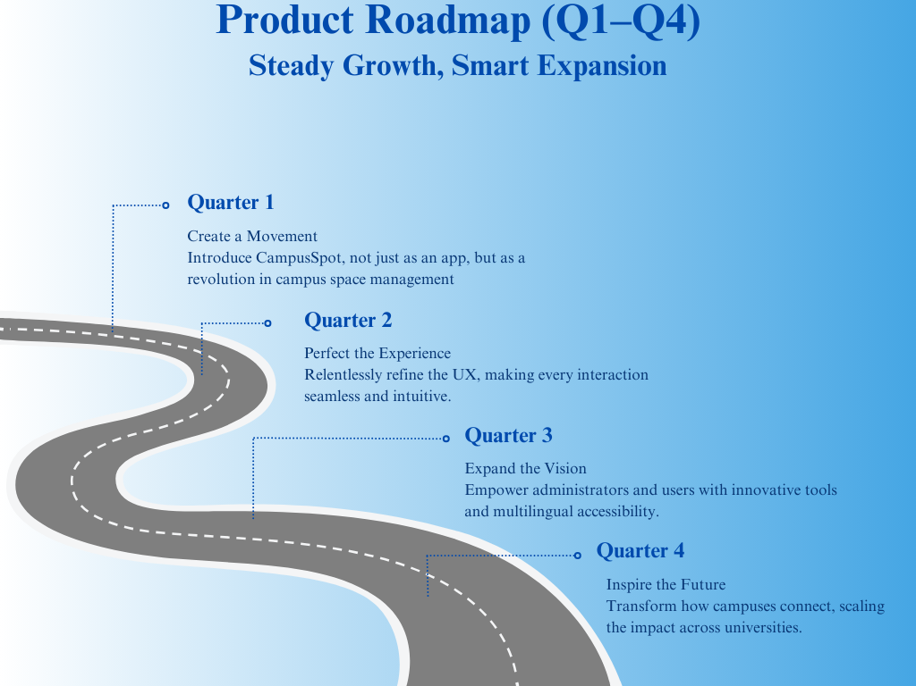
Product Roadmap (Q1–Q4)
Steady Growth, Smart Expansion

Slide 9




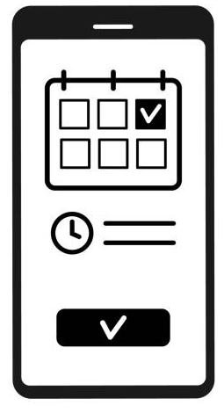



Product Features - Key Features for All Users
Real-Time Updates
Intelligent Noise Tracking
Data Insights for Staff
Seamless Communication
Advanced Filtering Options
Smart Booking & Check-Ins
General Area Seating Tracking

Slide 10

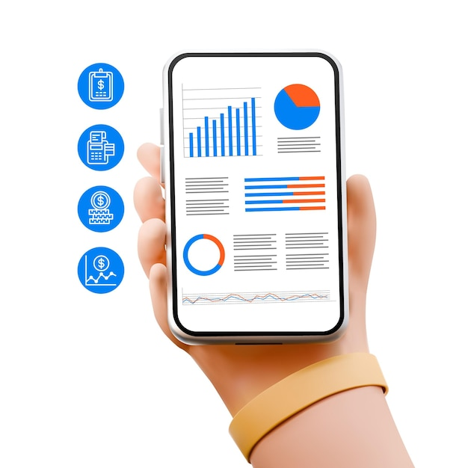
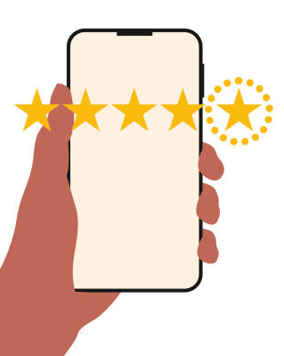

Core MVP Features - Ready for Launch
Students/ Faculty
Staff
Search and Reserve Spaces
Insights via data visuals
Instant alerts for updates
Efficient request handling
Simple feedback system

Slide 11
Key Metrics
Search-to-Conversion Rate : Efficiency of converting searches into confirmed bookings.
Real-Time Occupancy: Tracks the accuracy of live seat availability data ensuring, trust and usability.
User Satisfaction Score: Reflects user experience through feedback ratings.
Space Utilization Rate: Percentage of booked spaces that are actually used.

Slide 12
Projected Costs – The Numbers That Build the Vision
Category | Estimated Cost
🛠 Development | $50,000
🎨 UX/UI Enhancements | $20,000
📊 Feedback Collection | $10,000
🏗 Infrastructure | $30,000
📣 Marketing & Outreach | $15,000
🛡️ Contingency Fund | $10,000
Total | $135,000
Notes:
Development – $50,000
Team Power: $40,000 to empower developers—the heart and soul of our app.
Precision Tools: $10,000 for advanced testing environments to ensure perfection.
UX/UI Enhancements – $20,000
Creative Excellence: $15,000 to craft designs that captivate and inspire.
Cutting-Edge Tools: $5,000 to bring ideas to life with innovation at its core.
Feedback Collection – $10,000
Smart Systems: $7,000 for automated tools that truly listen to users.
Human Touch: $3,000 to gather deep insights from personal surveys.
Infrastructure & Integration – $30,000
Campus Connectivity: $20,000 to seamlessly integrate with essential systems.
Reliable Operations: $10,000 to build fast, secure, and robust foundations.
Marketing & Outreach – $15,000
Digital Reach: $8,000 to amplify our voice with impactful campaigns.
Community Connection: $7,000 for events and content that create buzz and excitement.
Contingency Fund – $10,000
Prepared for the Unexpected: Ready to adapt, evolve, and overcome surprises.
Why This Matters
We’re not just building an app—we’re crafting a legacy. Every dollar is an investment in innovation, precision, and excellence. Together, these blocks ensure Campus Spot becomes the essential platform for every student.
"Innovation isn’t about money—it’s about making things better. This $135,000 isn’t a cost; it’s the foundation for a better future."

Slide 13
Operational Needs
Category | Requirements | Impact
🛠 Development | Testing and scalability | Smooth launch and growth
 | Cross-platform compatibility | Wider user reach
🎨 User Experience (UX) | Enhance interface design | Better Usability
 | Usability testing | Refined interactions
📊 User Feedback | Automate feedback collection | Identify improvements
 | Track user behavior | Data-driven decisions
🏗 Infrastructure | Integrate campus services | Expanded capabilities
📣 Marketing & Outreach | Onboard 2,000 users | Increased adoption
 | Optimize app store presence | Better discoverability
🤝 Customer Support | Responsive support system | Enhanced satisfaction and loyalty
✅ Compliance | Privacy law compliance | Avoid legal risks

Slide 14





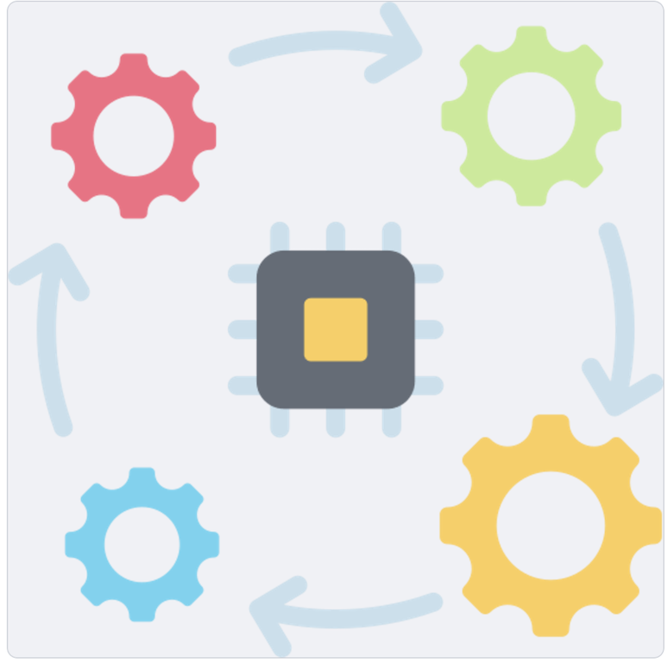


Risk Mitigation Plan
Privacy Concerns
Piracy Concerns
User Adoption
Anonymize user data and secure storage
Use encryption and access controls
Create a user-friendly app with tutorials
University System Interdependencies
Legal/Patent Risks
Operational Dependencies
Conduct early patent research with legal support
Optimize for low connectivity and offline use
Ensure compatibility with regular checks

Slide 15
THANK YOU

